Slide 1
CS217 – Object Oriented Programming (OOP)
Week – 04
Mar 1-5, 2021
Instructor: Basit Ali

Slide 2
Static Members of a C++ Class
We can define class members static using static keyword.
When we declare a member of a class as static it means no matter how many objects of the class are created, there is only one copy of the static member.
A static member is shared by all objects of the class.

Slide 3
Static Members of a C++ Class
It can be initialized outside the class using the scope resolution operator :: to identify which class it belongs to.
All static data is initialized to zero when the first object is created, if no other initialization is present.

Slide 4
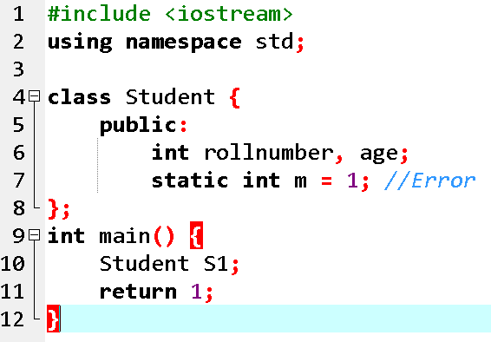
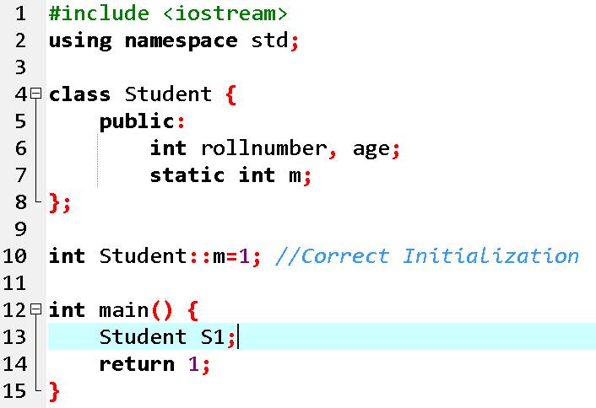
Concept: Static Members is initialized outside the class

Slide 5
Static int variable gets memory when program starts and int gets memory when the FUN is called. The X memory is not destroyed till the program is end and Y destroys when work of FUN is completed. 2. When FUN is called many times then memory of Y is made and destroyed again and again. But X is called only one time and ONLY one copy exists till the end of the program, not destroys during the execution of the program.
#include<iostream> int main() { fun() //STATIC variable contains by default ZERO value, don’t depend upon the OBJECT { static int x; (( static member variable or class variable)) int y; (( instance member variable))
}
}
}

Slide 6
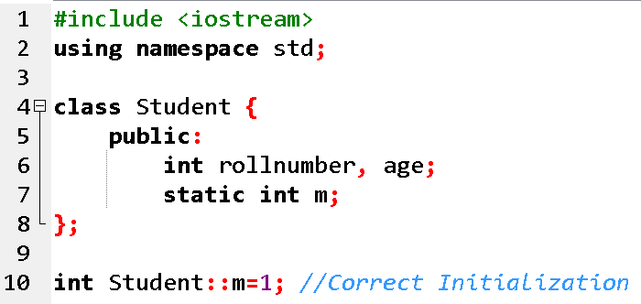
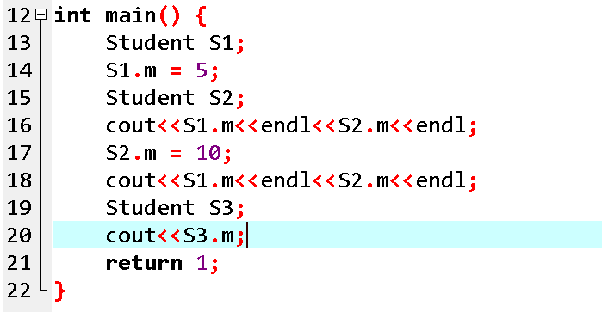
Concept: A static member is shared by all objects of the class

Slide 7
Static Member Functions of a C++ Class
By declaring a function member as static, you make it independent of any particular object of the class.
A static member function can be called even if no objects of the class exist and the static functions are accessed using only the class name and the scope resolution operator :: .

Slide 8
Static Member Functions of a C++ Class
A static member function can only access static data member, other static member functions and any other functions from outside the class.

Slide 9
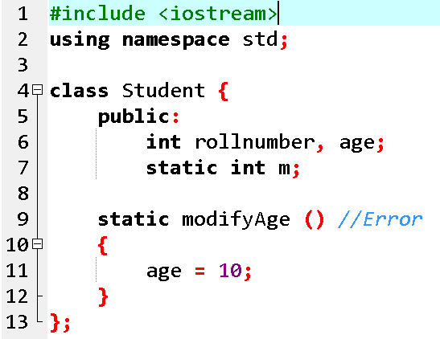
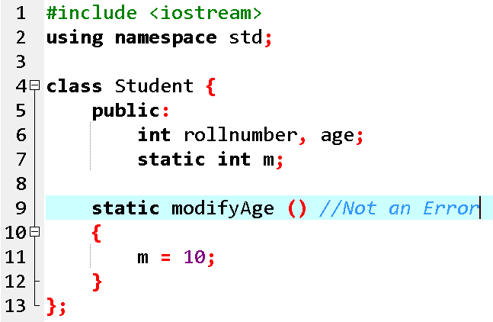
Concept: A static member function can only access static data member

Slide 10
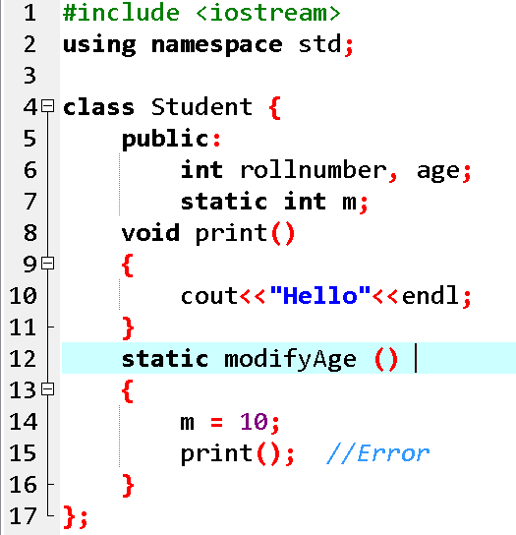
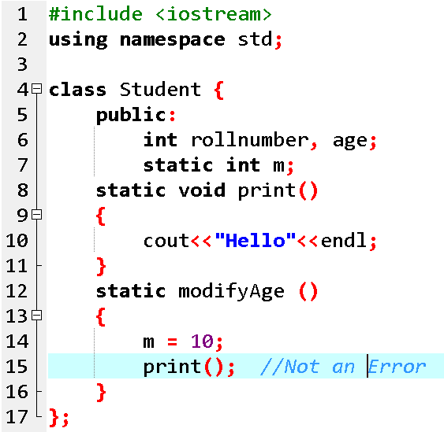
Concept: A static member function can only access other static member functions

Slide 11
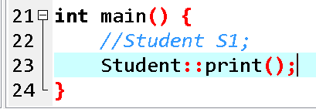
Because static member functions are not attached to a particular object, they can be called directly by using the class name and the scope resolution operator. This is because non-static members must belong to a class object, and static member functions have no class object to work with!

Slide 12
const Keyword in C++
Constant is something that doesn't change.
In C language and C++ we use the keyword const to make program elements constant.
const keyword can be used in many contexts in a C++ program. It can be used with:
1) Variables 2) Pointers 3) Function arguments 4) Class Data members 5) Class Member functions 6) Objects

Slide 13
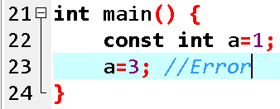
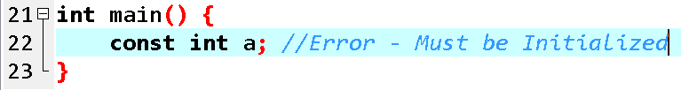
1) Constant Variables in C++
If you make any variable as constant, using const keyword, you cannot change its value. Also, the constant variables must be initialized while they are declared.

Slide 14
2) Pointers with const keyword in C++
Pointers can be declared using const keyword too.
When we use const with pointers, we can do it in two ways, either we can apply const to what the pointer is pointing to, or we can make the pointer itself a constant.

Slide 15
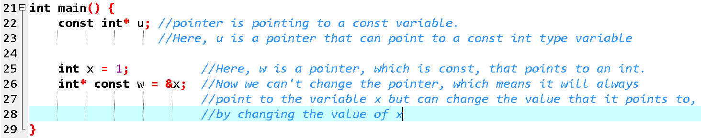
2) Pointers with const keyword in C++

Slide 16
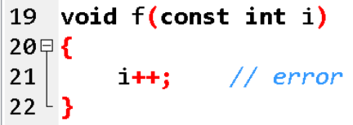
3) Function with constant Arguments
We can make the arguments of a function as const. Then we cannot change any of them.

Slide 17
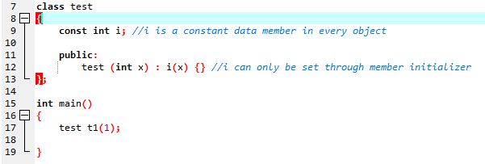
4) Defining Class Data members as const
These are data variables in class which are defined using const keyword. They are not initialized during declaration. Their initialization is done in the constructor.

Slide 18
5) Defining Class Object as const
When an object is declared or created using the const keyword, its data members can never be changed, during the object's lifetime.
Syntax:
const class_name object;

Slide 19
6) Defining Class's Member function as const
A const member function never modifies data members in an object.
Syntax:
return_type function_name() const;

Slide 20
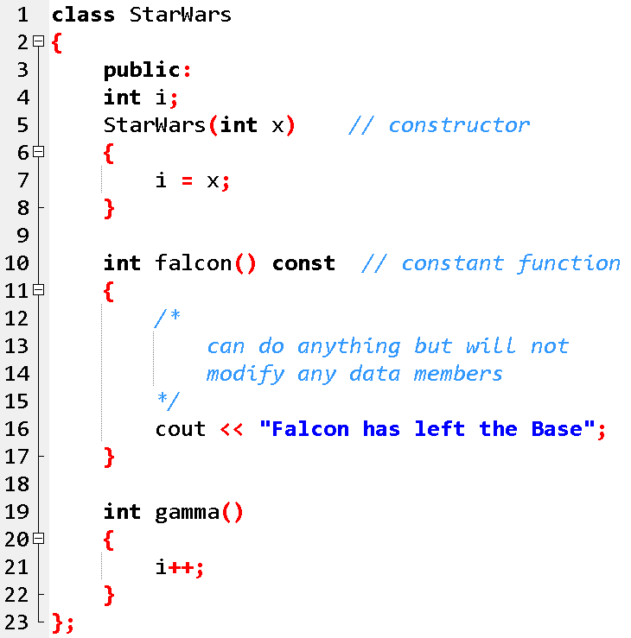
Example for const Object and const Member function

Slide 21
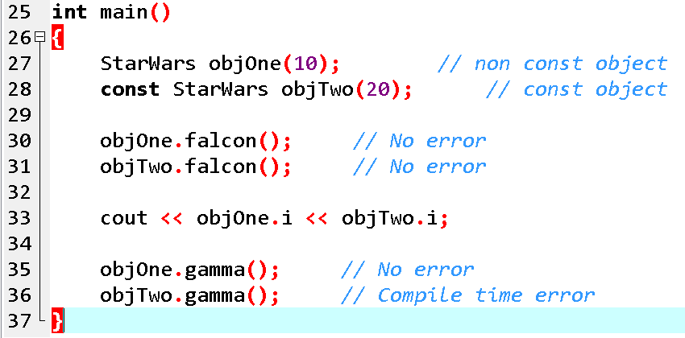
Example for const Object and const Member function

Slide 22
Mutable Keyword
mutable keyword is used with member variables of class, which we want to change even if the object is of const type. Hence, mutable data members of a const objects can be modified.

Slide 23
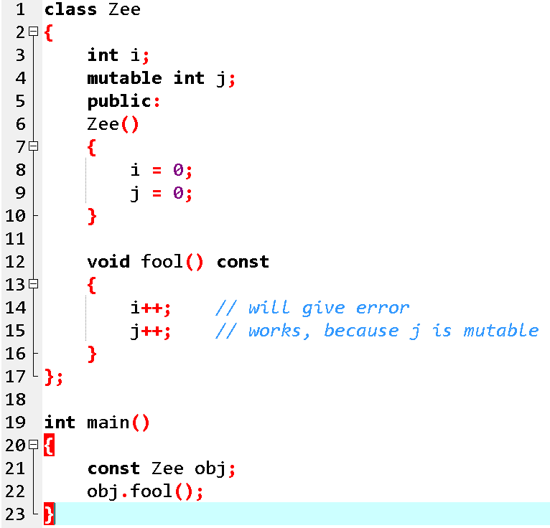
Example: Mutable

Slide 24
Reading Assignment!
Dietel, 7th Edition
Classes: A Deeper Look, Part 2
10.2 const (Constant) Objects and const Member Functions
10.6 static Class Members

Slide 25
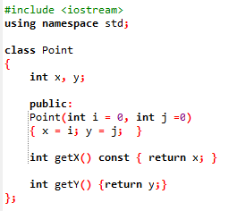
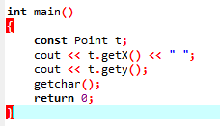
Exercise!

Slide 26
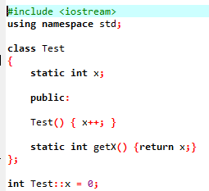
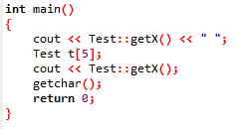
Exercise!

Slide 27
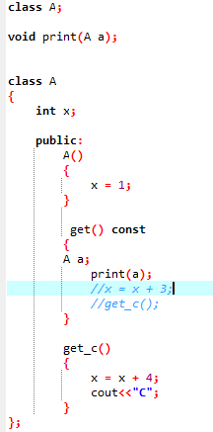
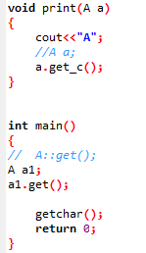
Exercise!

Slide 28
Saving Account Class
Create a SavingsAccount class. Use a static data member annualInterestRate to store the annual interest rate for each of the savers. Each member of the class contains a private data member savingsBalance indicating the amount the saver currently has on deposit. Provide member function calculateMonthlyInterest that calculates the monthly interest by multiplying the balance by annualInterestRate divided by 12; this interest should be added to savingsBalance. Provide a static member function modifyInterestRate that sets the static annualInterestRate to a new value. Write a driver program to test class SavingsAccount. Instantiate two different objects of class SavingsAccount, saver1 and saver2, with balances of $2000.00 and $3000.00, respectively. Set the annualInterestRate to 3 percent. Then calculate the monthly interest and print the new balances for each of the savers. Then set the annualInterestRate to 4 percent, calculate the next month’s interest and print the new balances for each of the savers.

